Slide 1
SIDDAGANGA INSTITUTE OF TECHNOLOGY Department of Computer Science and Engineering
Essay Grader and Recommendation
using Machine Learning Techniques
Submitted by:
Batch: B26
Praglva Jung Budhathoki (1SI17CS075)
Rabindra Basnet (1SI17CS080)
Rishav Karanjit (1SI17CS089)
Ritesh Prasad Yadav (1SI17CS090)
Panel convener and guide name:-
Dr. KG Manjunath Sir

Slide 2
INTRODUCTION
Essays are crucial testing tools for assessing academic achievement, integration of ideas and ability to recall, but are expensive and time consuming to grade manually.
Manual grading of essays takes up a significant amount of instructors' valuable time, and hence is an expensive process.
Automated grading, if proven to match or exceed the reliability of human graders, will significantly reduce costs.
The purpose of this project is to implement and train machine learning algorithms to automatically assess and grade essay responses.
These grades from the automatic grading system should match the human grades consistently.

Slide 3
OBJECTIVES
To score the essay based on: Coherence, Clarity, Vocabulary, Style, Organization
To test for plagiarism in the essay.
To give following details of essay: number of words, unique words, average word length per sentence, number of grammatical mistake and number of spelling mistakes.
To recommend how an essay could be better.

Slide 4
PROJECT RELEVANCE to STATE-OF-THE-ART
Our project can be applicable in future for following purposes:
Students could be helped in the writing section of different aptitude exams
Students could be suggested how the writing of student could improve
Plagiarism test could be done in essay
Mostly our application will be helpful in future for students.

Slide 5
Literary Survey
Automatic Essay Scoring
Link: http://www.cs.cmu.edu/~norii/pub/aes.pdf
Description : In this paper, it is shown how linear regression can be used to automatically grade essays on standardized tests. This paper combines simple, shallow features of the essays, such as character length and word length, with part-of-speech patterns.
Automated Essay Scoring based on Two-Stage Learning
Link: https://arxiv.org/pdf/1901.07744
Description : This paper focuses on the problem to develop a Two-Stage Learning Framework (TSLF) which integrates the advantages of both feature-engineered and end-to-end AES methods. In experiments, this paper compare TSLF against a number of strong baselines, and the results demonstrate the effectiveness and robustness of our models.

Slide 6
Planning Of The Project
7th Semester | 8th Semester
Requirement gathering Design of UI Collection of details in the essay using NLP that will be used in Machine learning model in 8th semester | Completion of UI design Design of Machine learning model Implementation of ML model using data collected in 7th semester
Budget Estimation Of The Project
Items | Cost | Usage
Grammarly premium | Rs. 1500 | To check the correctness of machine learning model

Slide 7
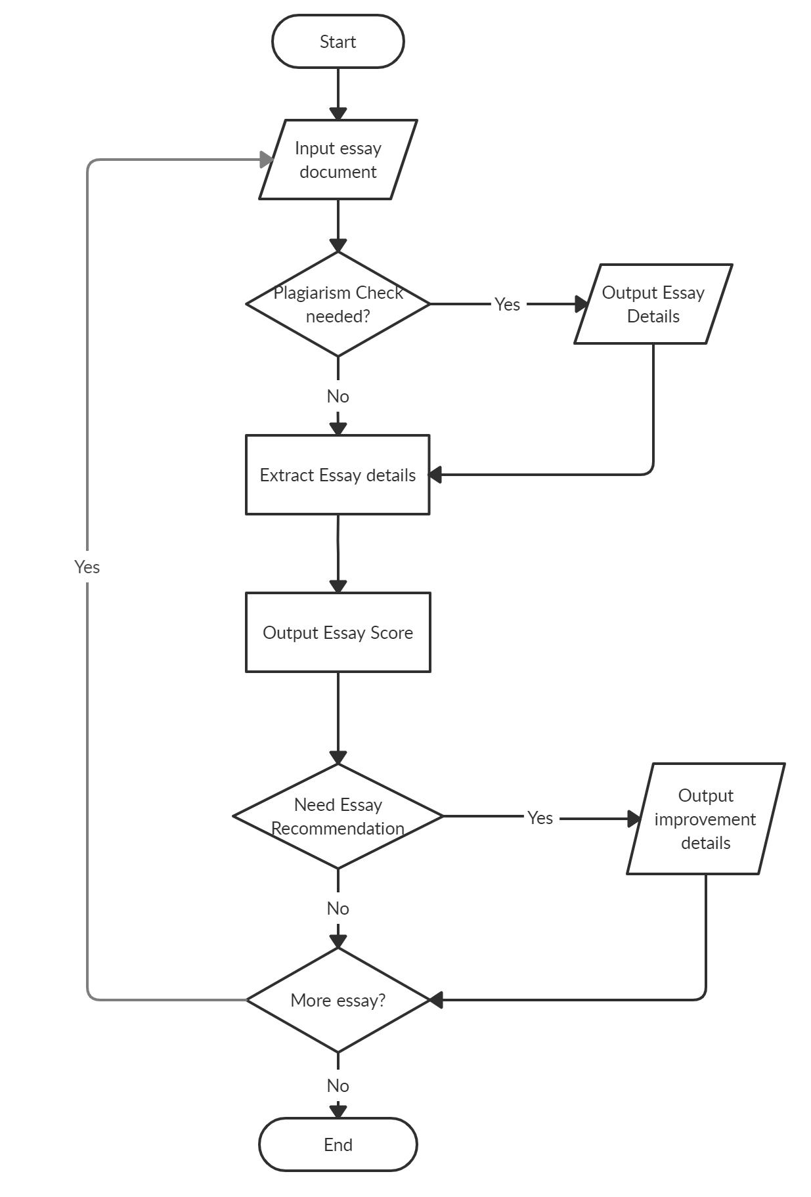
Architecture, Design and Methodology
Flow Chart of the project

Slide 8
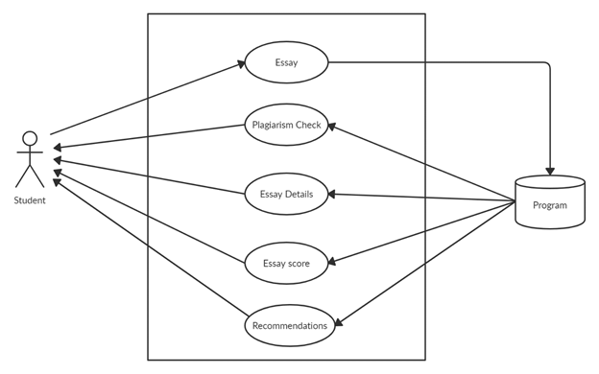
Architecture, Design and Methodology
Use case diagram:

Slide 9
TOOLS AND TECHNOLOGY
Frontend : | Pyqt5(python framework) CSS
Backend: | Python 3.8 (Since numerous library exists)
Database: | MySql
Tools: | Natural Language Toolkit(NLTK) Scikit-learn(to implement regularized linear regression.) Opencv,python docx

Slide 10
EXPECTED OUTCOMES
Our project is expected to score essay with very high accuracy.
Our plagiarism test will be very helpful if someone has copied essay from internet.
The word detail, unique word detail and other other details will help student in determining which part they should improve.
Our project will be capable to tell user what to change and where to change in the essay so that students can improve future essay writing

Slide 11
Modules for prototype demonstration in phase 2
Natural Language Processing Toolkit:
To process the essay details
Language-check module:
To check the grammar of the essay
Pyqt5:
To design the UI of the prototype

Slide 12
Thank You

